Slide 1
Design Pattern Catalogs
Pattern catalogs are group of patterns, generally organized according to function or purpose.
This course focuses primarily on two pattern catalogs:
→ GoF catalog : Developed by 4 analysts Erich Gamma, Richard Helm, Ralph Johnson and John Vlissides for OO development.
→ J2EE catalog : Developed by Sun Professional Services from their experience designing J2EE platform applications.
Compiled By Dr. Rajesh Upadhyay

Slide 2
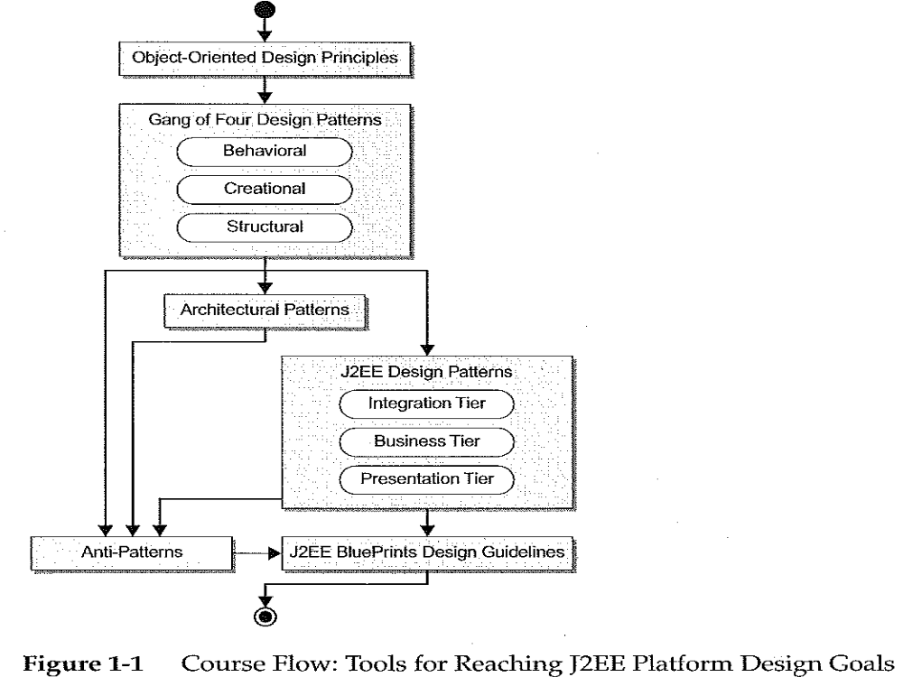
Compiled By Dr. Rajesh Upadhyay

Slide 3
Design Pattern Catalog
CREATIONAL PATTERNS
Factory Method
Abstract Factory
Builder
Prototype
Singleton
BEHAVIORAL PATTERNS
Chain of Responsibility
Command
Interpreter
Iterator
Mediator
Memento
Observer
State
Strategy
Template Method
Visitor
STRUCTURAL PATTERNS
Adapter
Bridge
Composite
Decorator
Façade
Flyweight
Proxy
Compiled By Dr. Rajesh Upadhyay
Notes:
Creational Patterns deal with initializing and configuring classes and objects.
Structural Patterns deal with decoupling interface and implementation of classes and objects.
Behavioral Patterns deal with dynamic interactions among classes and objects.
There are other design patterns in existence but these are the most common

Slide 4
Object Oriented Design Concepts
Effective use of the fundamental object- oriented concepts can improve an application design.
These fundamental concepts are the foundation that object-oriented design patterns and J2EE design patterns build upon.They are:
→ Cohesion
→ Encapsulation
→ Coupling
→ Implementation Inheritance
→ Composition
→ Interface Inheritance
→ Polymorphism
Compiled By Dr. Rajesh Upadhyay

Slide 5
Cohesion
Cohesion is the degree to which the methods and attributes of a class focus on only one purpose in the system.
→ Low Cohesion : Many unrelated functions within the same component.(Big classes with many unrelated functions are usually hard to maintain).
→ High Cohesion : Only related functions within the same component.(Small classes with fewer, highly related functions are usually easier to maintain).
Consequences :
→ Avoids side affects of changing unrelated code within the same
class .
→ Improves code readability by clarifying the role of a class.
→ Facilitates the creation of small reusable components.
Compiled By Dr. Rajesh Upadhyay

Slide 6
Encapsulation
Encapsulation includes information hiding, where implementation details are hidden behind a set of public methods.
Make all attributes private. Accessor and mutator methods should be used to provide an interface to the data held within the object.
Consequences :
→Allows the implementation of a class to vary without
changing the interface that other classes use to access it.
→ Allows developers of other classes to use the class
without knowing all of its implementation details.
→Prevents inappropriate modifications of an object’s
attributes.
Compiled By Dr. Rajesh Upadhyay

Slide 7
Coupling
Coupling is a measure of how dependent classes are on other classes.
The tighter the coupling between two classes, the more likely that a change in one class will require a change in the second class.
Four different levels of coupling are :
→ Tight coupling
→ Looser coupling
→ Looser abstract coupling
→ No coupling
Methods to reduce coupling between classes :
  → Hide the implementation of the classes .
  → Couple the first class to only the abstract interface of the
  second class.
  → Reduce the number of methods in the interface of the class.
Compiled By Dr. Rajesh Upadhyay

Slide 8
Implementation Inheritance
Here, a subclass inherits the concrete methods from a super class, thereby inheriting the functionality of the super class.
Consequences
  → Organizes classes according to inheritance relationships.
  → Avoids duplication of code that is common to all classes.
  → It is the highest form of coupling.
  → Forces sub class to inherit everything from its super class,
  even when it is not appropriate for that subclass.
  → Changes to the super class can affect the sub class.
Compiled By Dr. Rajesh Upadhyay

Slide 9
Composition
Composition build complex objects from simpler objects, which can be built from even simpler objects.
These objects form an object hierarchy where one object uses another as part of its implementation.
Composition is a loosely coupled relationship between classes based on delegation rather than reliance on implementation details.
Compiled By Dr. Rajesh Upadhyay

Slide 10
Interface Inheritance
Interface inheritance is the separation of an interface definition from the implementation.
Helps maintain loose coupling.
Java interface is usually preferable because it supports pure interface inheritance and allows a class to inherit multiple interfaces.
Compiled By Dr. Rajesh Upadhyay

Slide 11
Polymorphism
Polymorphism provides the ability to invoke the operations of specific objects through generic reference.
→ A variable can be assigned different types of
objects at runtime.
→ The type of object, not the type of the declaration,
determines the method implementation.
Compiled By Dr. Rajesh Upadhyay

Slide 12
Exploring OO Design Principles
The GoF book outlines three OO design principles. These design principles build upon the fundamental OO concepts and provides a foundation for the GoF design patterns.
→ Favoring composition.
→ Programming to an interface.
→ Designing for change.
Compiled By Dr. Rajesh Upadhyay

Slide 13
Favoring Composition
“ Favor object composition over implementation inheritance”.
It describes why it is better to reuse functionality through composition than through implementation inheritance.
Implementation inheritance is a white–box reuse. Here the sub class is exposed to the internal implementation of the super class.
Composition is a black-box reuse. Here the client is exposed only to the interface of the class that it uses. Thus the coupling that uses composition is looser.
Compiled By Dr. Rajesh Upadhyay

Slide 14
Programming to an interface
“Program to an interface, not an implementation”
Also called as Dependency Inversion Principle.
This principle says that classes should depend upon abstractions, not on implementations.
Compiled By Dr. Rajesh Upadhyay

Slide 15
Designing for change
Also called as Open-Closed Principle.
States that software entities, such as classes, should be open for extension, but closed for modifications.
The main concern is to create systems that are adaptable and support new and changing requirements, without having major redesigns.
Compiled By Dr. Rajesh Upadhyay

